Slide 1
Rialto bridge
By Hunter

Slide 2
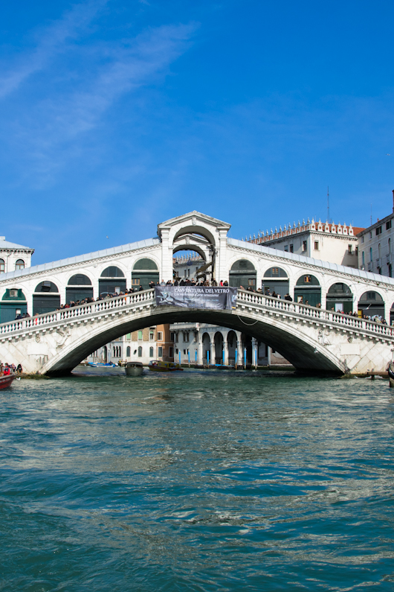
Interesting facts
. The engineer Antonio De Ponte shot a canon on it and it held
The Rialto Bridge competed with other designers such as . .Michelangelo and Palladio
. The Rialto Bridge is the oldest bridge spanning the Grand Canal

Slide 3
WHERE IT IS
The Rialto Bridge is the heart of Venice,Italy

Slide 4
Length and width
Height is 24 Ft tall
Width is 20 meters
Length is 25 meter (82) Ft

Slide 5
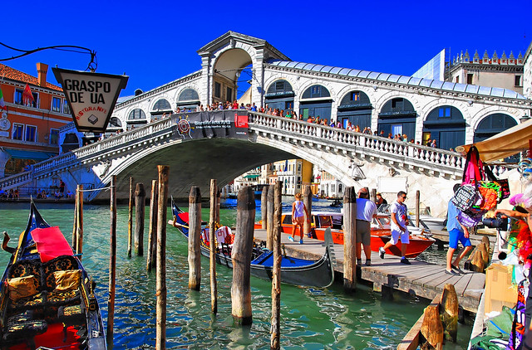
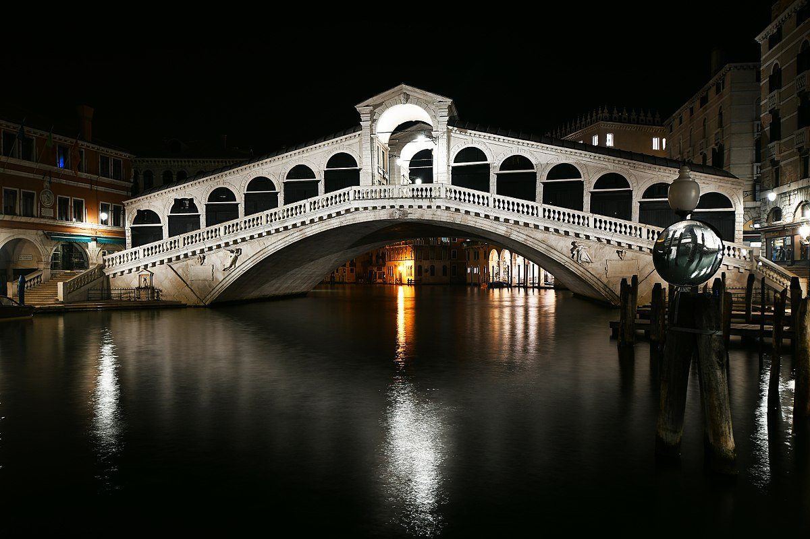
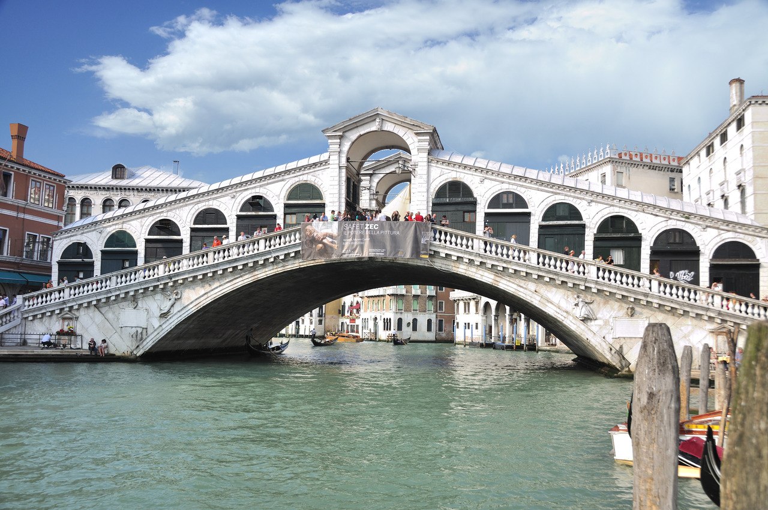
Pictures of the rialto bridge

Slide 6
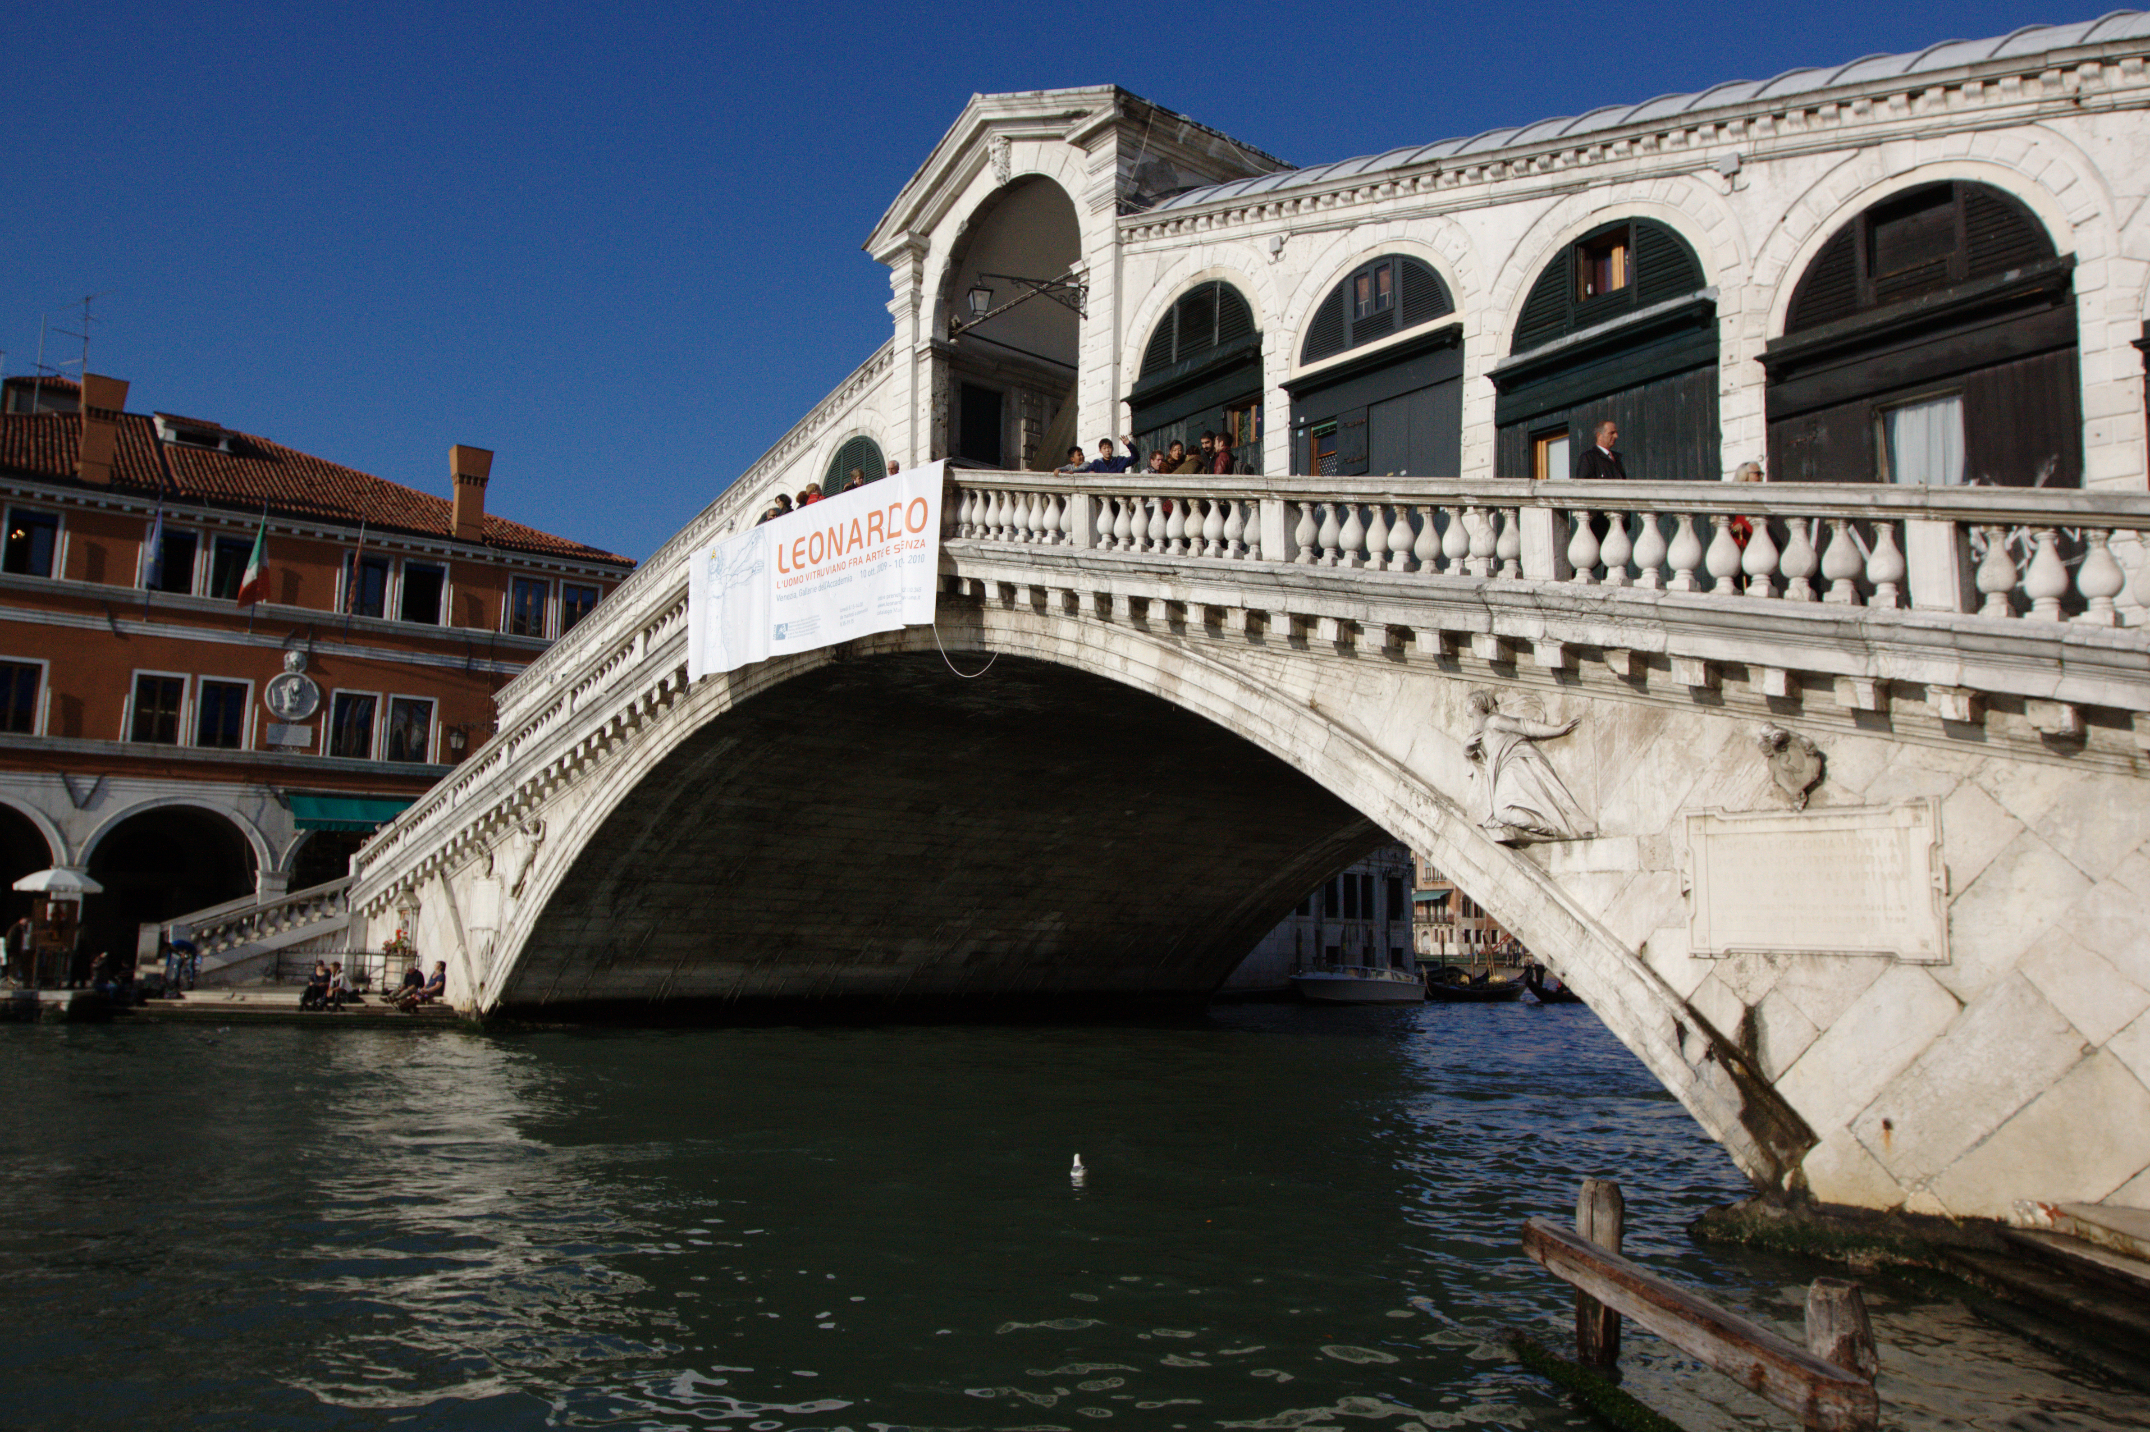
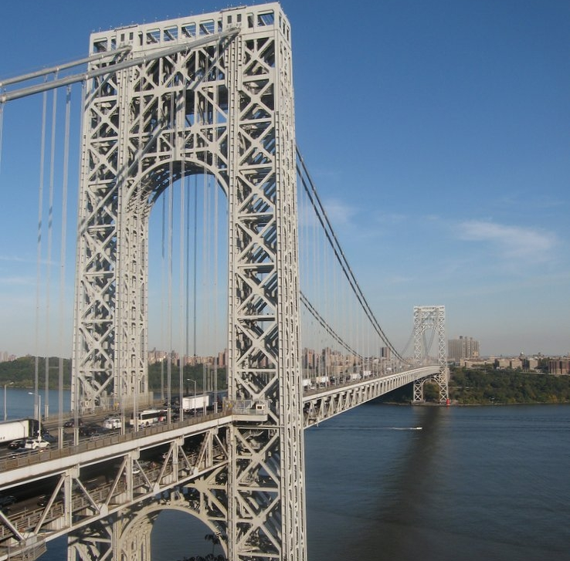
Comparing with another bridge
Shorter and lower
24 FT
25 meters tall
Taller and longer
2,196 meters long
604 FT tall
(this is the George WashingtonBridge)
In Venice, Italy
In New York City

Slide 7
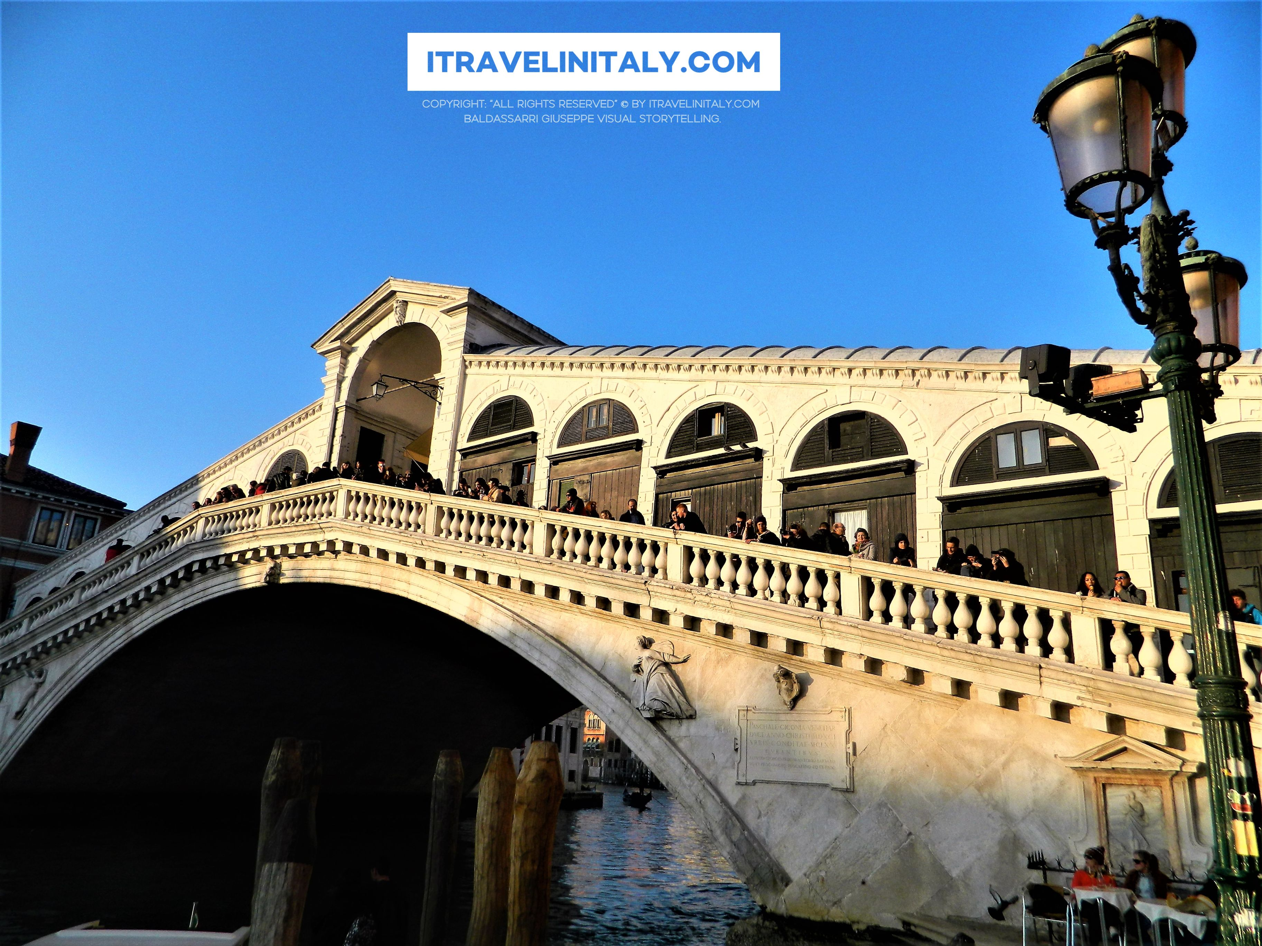
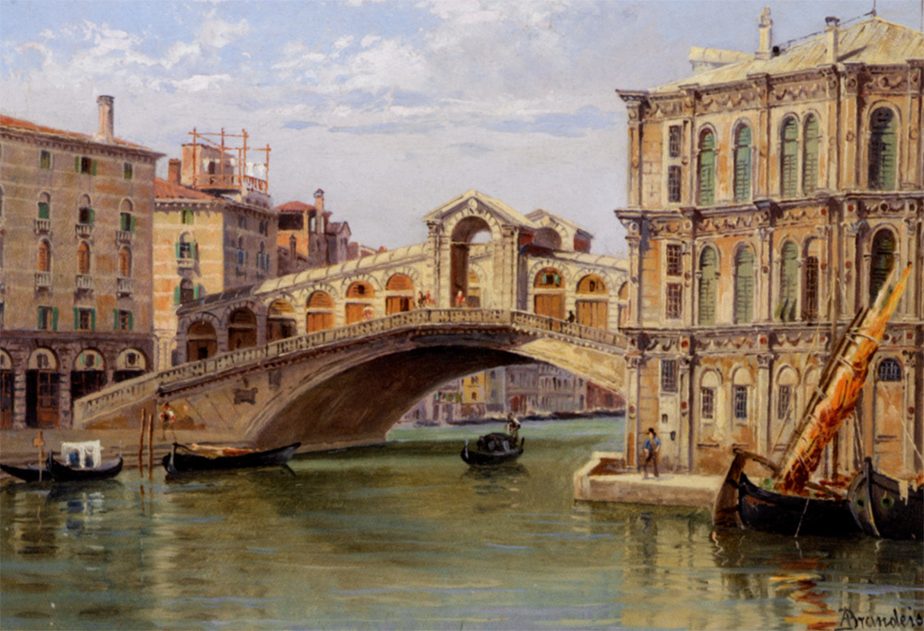
Researched and produced by Hunter
3rd grade
Buck Lake elementary school
WOW what a pretty picture

Slide 8
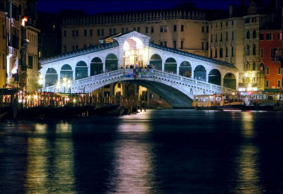
Goodbye and thank you

